Slide 1


Profit Allocation for Federated Learning
Tianshu Song, Yongxin Tong，Shuyue Wei {songts, yxtong, weishuyue}@buaa.edu.cn Beihang University
Notes:
Hi everyone. We are Tianshu Song, Yongxin Tong and Shuyue Wei from Beihang University.
Today, we will present our work, Profit Allocation for Federated Learning.

Slide 2
Outline
Background and Motivation
Preliminary and Definition
Methods
Experiments
Conclusion
Notes:
This is the outline.
The first part is background and motivation

Slide 3



Background and Motivation
Machine learning is very popular
Traditional production model of machine learning services is risky
Step 1: Data Collection
Step 2: Model Training
Step 3: Model Service
Notes:
We all know that machine learning nowadays is very popular and has been used wildly in many areas.
However, traditional production model of machine learning service is risky.
In traditional mode, data is first collected and then used to train model.

Slide 4
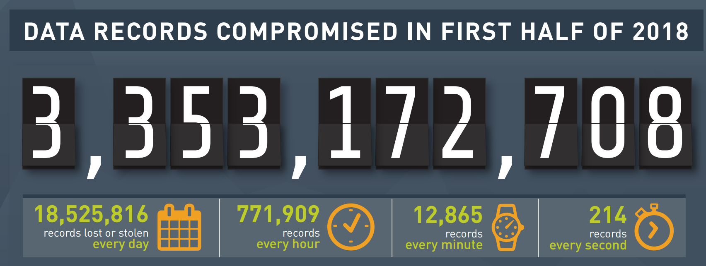
Background and Motivation
Machine learning is very popular
Traditional production model of machine learning services is risky
Step 1: Data Collection
More than 3 billion data records was compromised
In the first half of 2018
Notes:
However, the collected data is possible to be leaked.
According to a report, more than 3 billion data records was compromised in the first half of 2018.

Slide 5
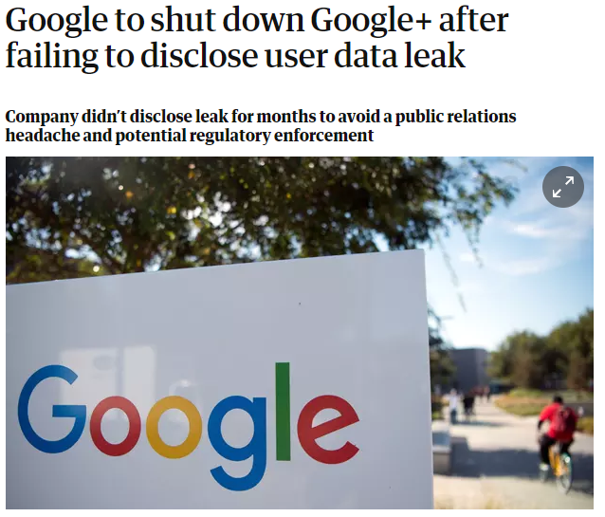
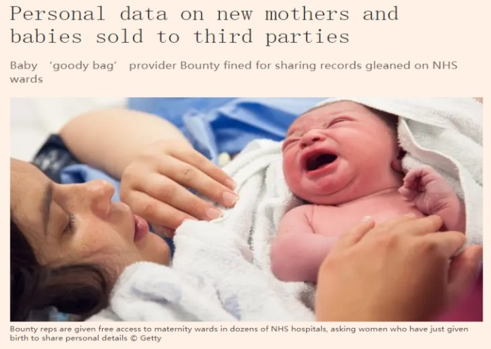
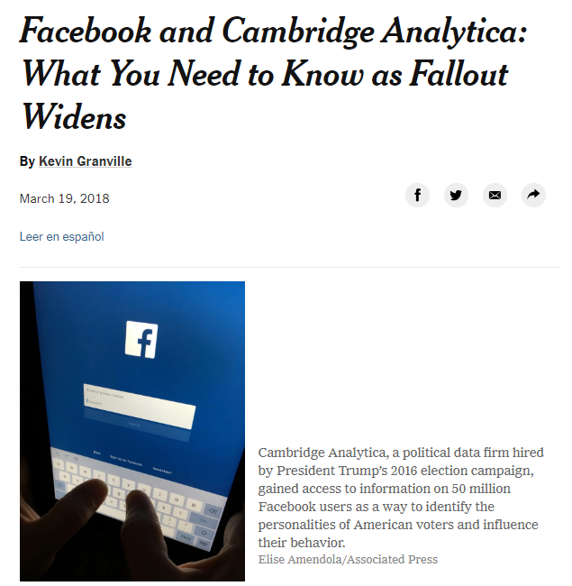
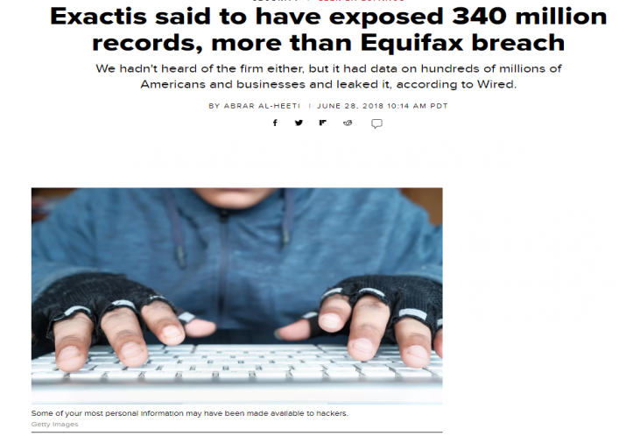
Background and Motivation
Notes:
Many famous companies, such as Google and Facebook, were involved into data leakage.

Slide 6
Background and Motivation
More and more strict regulations on data protection, such as GDPR
Notes:
To protect data, more and more strict regulations on data protection, are formulated, such as GDPR, which is a regulation in EU law on data protection and privacy for all individual citizens of the European Union and the European Economic Area.
To comply with these regulations, new production model of machine learning service is needed.

Slide 7









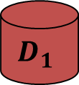
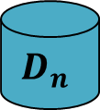
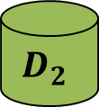

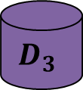
Background and Motivation
Federated learning
$$D_{1}$$
$$D_{2}$$
$$D_{3}$$
$$⋯$$
$$D_{n}$$
Notes:
Federated learning is proposed by Google to solve this problem, with different parties train a model jointly while keep their own data locally.

Slide 8

Background and Motivation
Incentive mechanism is important for FL
Data providers should be motivated to join in federated learning
The way to allocate the profit earned by federated model should be reasonable
Notes:
To make federated learning practical in industrial scenario, it is indispensable to evaluate the contribution of different data providers and thus the profit earned by the federated model can be allocated. Based on evaluating the contribution reasonably, incentive mechanisms can be designed to attract more data owners to join in federated learning.

Slide 9
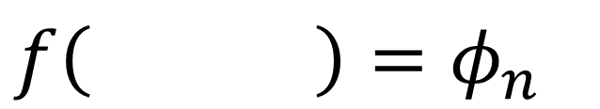

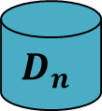
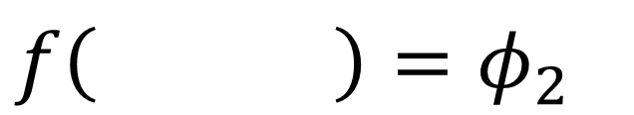
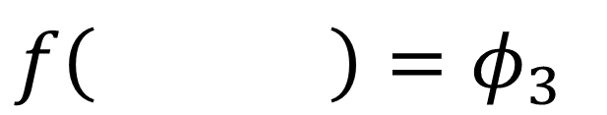
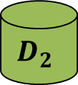
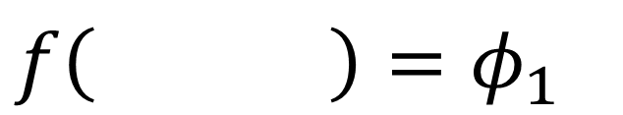
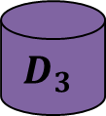
Background and Motivation
Our Goal
Propose a definition to evaluate the contributions of different data sets in federated learning
Efficient and effective calculation methods
$$f\left( \right)=φ_{1}$$
$$f\left( \right)=φ_{3}$$
$$D_{1}$$
$$D_{3}$$
$$f\left( \right)=φ_{2}$$
$$f\left( \right)=φ_{n}$$
$$D_{2}$$
$$D_{n}$$
Notes:
In this work, our goal is to first propose a definition to evaluate the contributions of different data sets in federated learning and the design efficient and effective calculations methods.

Slide 10
Outline
Background and Motivation
Preliminary and Definition
Methods
Experiments
Conclusion
Notes:
We next introduce the Preliminary and Definition

Slide 11
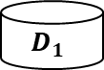
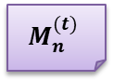
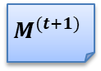
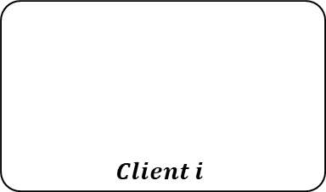
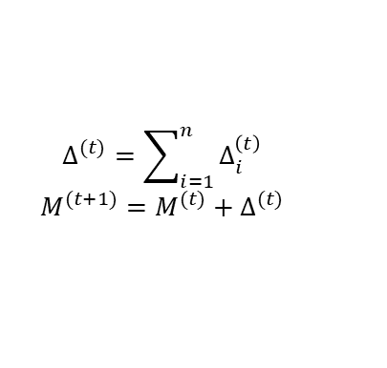
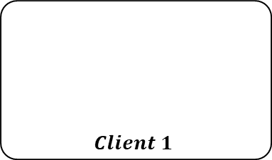
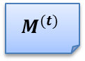
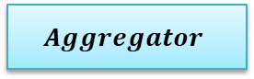
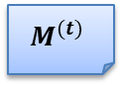
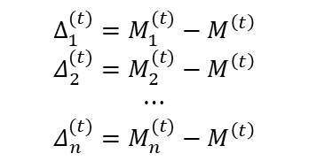
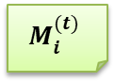
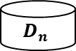
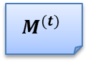
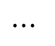

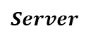
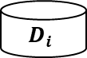
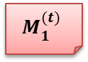
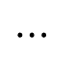
Preliminary and Definition
Federated Learning Framework
$$Δ_{1}^{(t)}=M_{1}^{(t)}−M^{\left(t\right)}$$
$$Δ_{2}^{(t)}=M_{2}^{(t)}−M^{\left(t\right)}$$
$$⋯$$
$$Δ_{n}^{(t)}=M_{n}^{(t)}−M^{\left(t\right)}$$
$$Δ^{(t)}=\sum_{i=1}^{n}{Δ_{i}^{\left(t\right)}}$$
$$M^{(t+1)}=M^{(t)}+Δ^{(t)}$$
$$Server$$
$$M^{(t)}$$
$$Aggregator$$
$$M^{(t+1)}$$
$$Client 1$$
$$Client i$$
$$Client n$$
$$M^{(t)}$$
$$M^{(t)}$$
$$M^{(t)}$$
$$M_{1}^{(t)}$$
$$⋯$$
$$M_{i}^{(t)}$$
$$⋯$$
$$M_{n}^{(t)}$$
$$D_{1}$$
$$D_{i}$$
$$D_{n}$$
Notes:
In our work, we adopt the federated learning framework proposed by Google.
In this frame work, the server first sends a global model called M t to the clients, where t denote the current training round.
Then, the clients train the received model M t using their own data and get model M t i.
Clients send the updated model M t I to the server.
Last, the server aggregates all the models M t i to get the global model M t plus 1 for the next training round.
The above steps are repeated until the global model is convergent.

Slide 12

Preliminary and Definition
Definition of Contribution Index
Given $n$ data set $D_{1},D_{2},⋯,D_{n}$, a federated machine learning algorithm $𝒜$, a standard test set $T$
Notes:
We next define a concept called Contribution Index
Given n data set D 1, D 2, till D n, a federated machine learning algorithm A and a standard test set T.

Slide 13
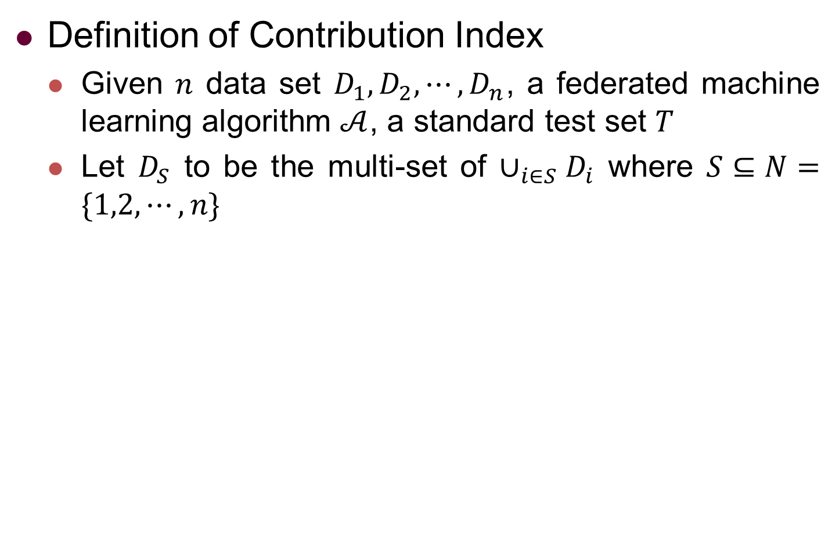
Preliminary and Definition
Definition of Contribution Index
Given $n$ data set $D_{1},D_{2},⋯,D_{n}$, a federated machine learning algorithm $𝒜$, a standard test set $T$
Let $D_{S}$ to be the multi-set of $∪_{i∈S}D_{i}$ where $S⊆N=\{1,2,⋯,n\}$
Notes:
We use D S to union multi-set of some of the n data sets.
S is a subset of N equals 1 2 till n to denote which data set is included and use M S to denote the model train on D S.
For example, if S equals the set of 1 and 2, D S then is the union of D1 and D2

Slide 14
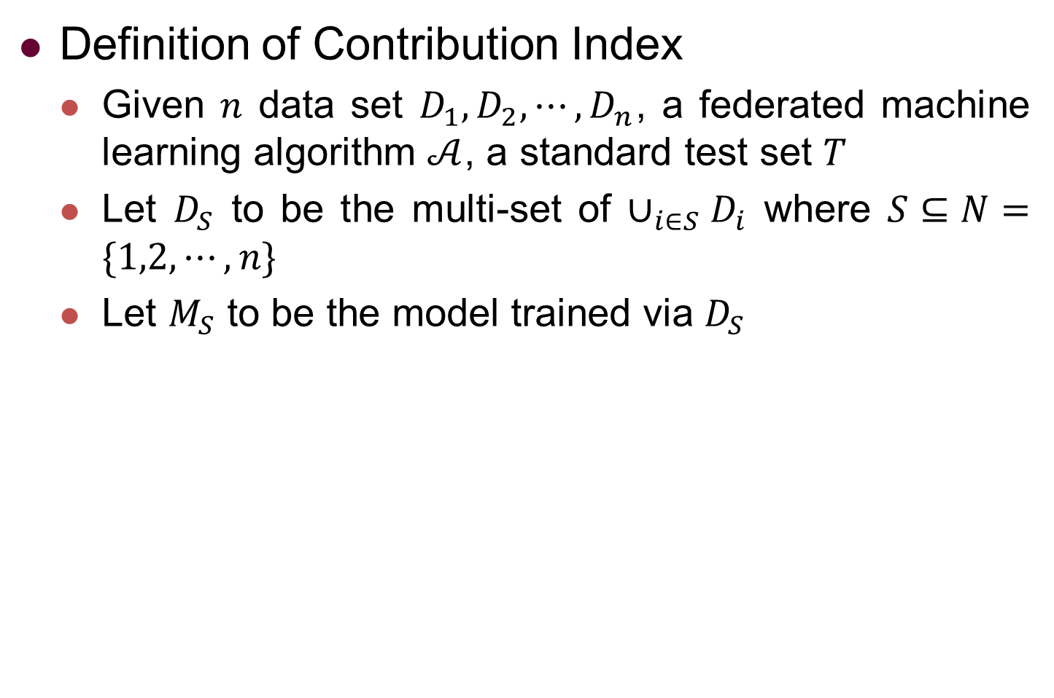
Preliminary and Definition
Definition of Contribution Index
Given $n$ data set $D_{1},D_{2},⋯,D_{n}$, a federated machine learning algorithm $𝒜$, a standard test set $T$
Let $D_{S}$ to be the multi-set of $∪_{i∈S}D_{i}$ where $S⊆N=\{1,2,⋯,n\}$
Let $M_{S}$ to be the model trained via $D_{S}$
Notes:
We use M s to denote the model trained on the data set of D S

Slide 15
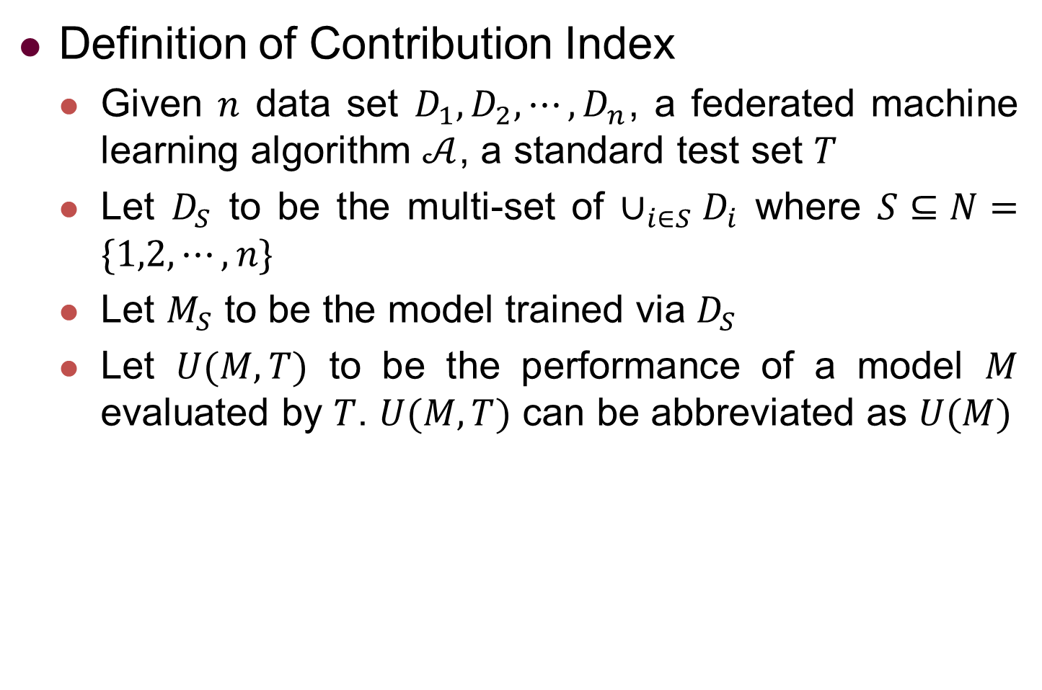
Preliminary and Definition
Definition of Contribution Index
Given $n$ data set $D_{1},D_{2},⋯,D_{n}$, a federated machine learning algorithm $𝒜$, a standard test set $T$
Let $D_{S}$ to be the multi-set of $∪_{i∈S}D_{i}$ where $S⊆N=\{1,2,⋯,n\}$
Let $M_{S}$ to be the model trained via $D_{S}$
Let $U(M,T)$ to be the performance of a model $M$ evaluated by $T$. $U(M,T)$ can be abbreviated as $U(M)$
Notes:
We use U M T to denote the performance of a model M evaluated by the standard test set T

Slide 16
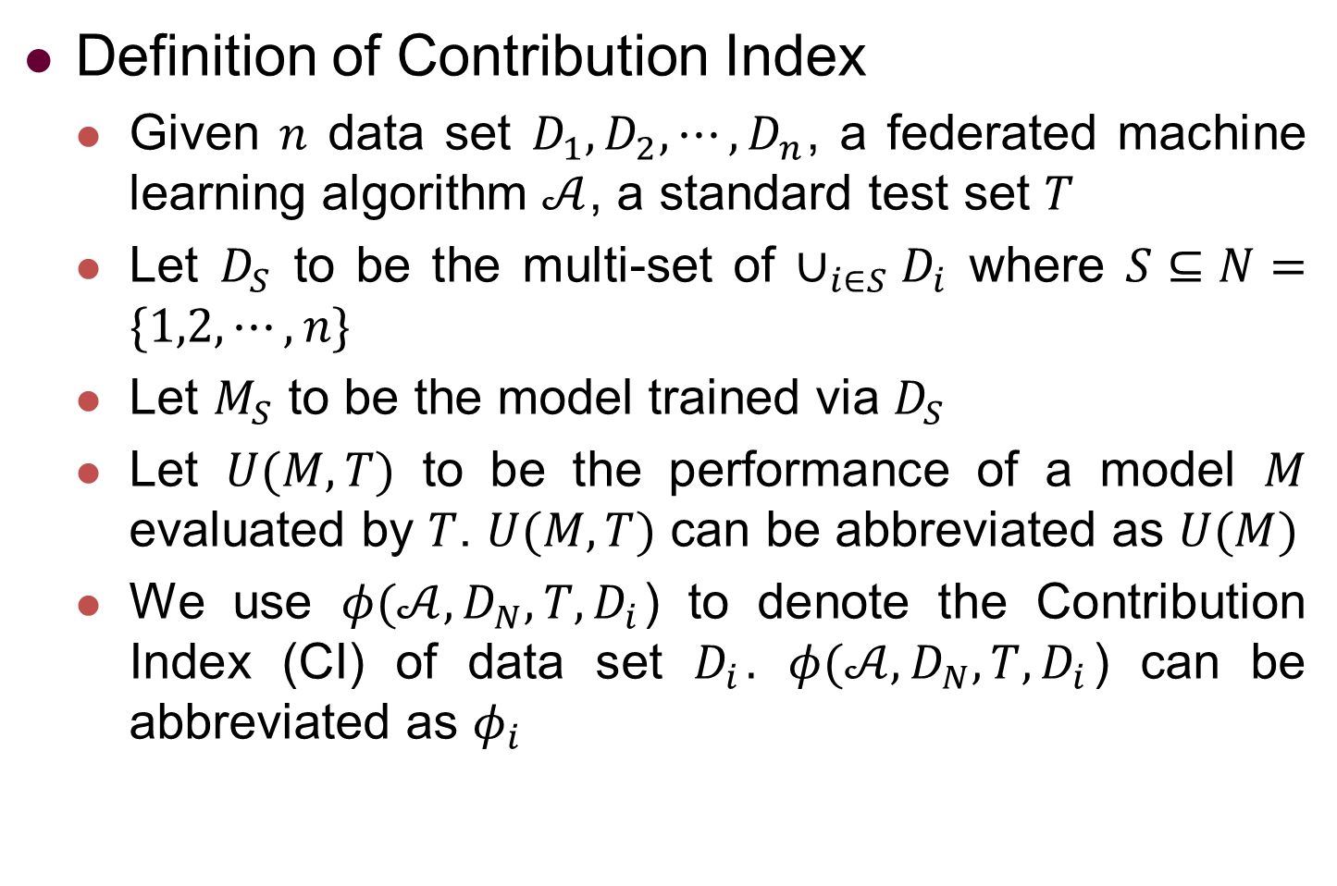
Preliminary and Definition
Definition of Contribution Index
Given $n$ data set $D_{1},D_{2},⋯,D_{n}$, a federated machine learning algorithm $𝒜$, a standard test set $T$
Let $D_{S}$ to be the multi-set of $∪_{i∈S}D_{i}$ where $S⊆N=\{1,2,⋯,n\}$
Let $M_{S}$ to be the model trained via $D_{S}$
Let $U(M,T)$ to be the performance of a model $M$ evaluated by $T$. $U(M,T)$ can be abbreviated as $U(M)$
We use $φ(𝒜,D_{N},T,D_{i}$) to denote the Contribution Index (CI) of data set $D_{i}$. $φ(𝒜,D_{N},T,D_{i}$) can be abbreviated as $φ_{i}$
Notes:
Finally, we use phi to denote the contribution index of data set D I given the federated machine learning algorithm, the other n-1 datasets and the standard test set T.
If the context is clear, phi I can be used as Abbreviation

Slide 17
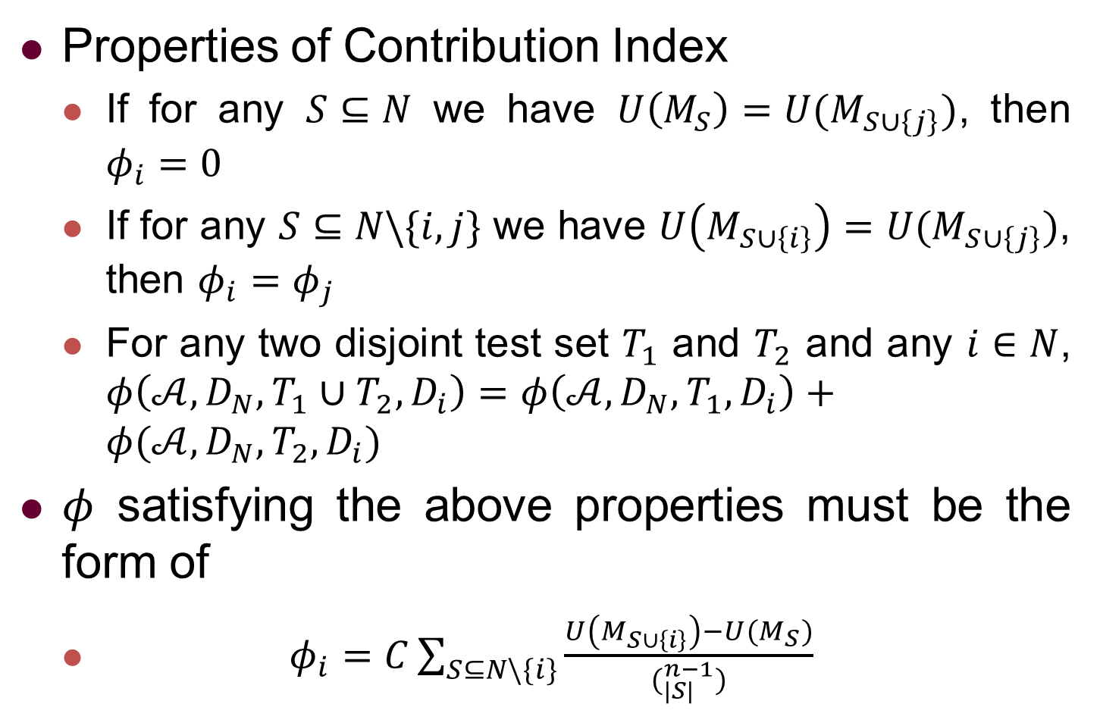
Preliminary and Definition
Properties of Contribution Index
If for any $S⊆N$ we have $U\left(M_{S}\right)=U(M_{S∪\left\{j\right\}})$, then $φ_{i}=0$
If for any $S⊆N\backslash \{i,j\}$ we have $U\left(M_{S∪\left\{i\right\}}\right)=U(M_{S∪\left\{j\right\}})$, then $φ_{i}=φ_{j}$
For any two disjoint test set $T_{1}$ and $T_{2}$ and any $i∈N$, $φ\left(𝒜,D_{N},T_{1}∪T_{2},D_{i}\right)=φ\left(𝒜,D_{N},T_{1},D_{i}\right)+φ(𝒜,D_{N},T_{2},D_{i})$
$φ$ satisfying the above properties must be the form of
$φ_{i}=C\sum_{S⊆N\backslash \{i\}}{\frac{U\left(M_{S∪\left\{i\right\}}\right)−U(M_{S})}{(_{|S|}^{n−1})}}$
Notes:
Our definition follows the concept of Shapley value, which is a classical concept in game theory proposed by and named in honour of Lloyd Shapley and is a solution in cooperative game theory which assigns a unique distribution of a total profit generated by the coalition of all players with a collection of desirable properties.
Following Shapley value, we also require contribution index to have the following properties.
First, if a data set have no contribution, its contribution index should be zero.
Second, if two data sets have the same contribution, their contribution indexes should be the same
Third, contribution index should be linear with respect to the test set.
It can been proven that a function with the above properties must have the form of this formula.

Slide 18
Outline
Background and Motivation
Preliminary and Definition
Methods
Experiments
Conclusion
Notes:
We next introduce our methods.

Slide 19
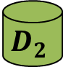
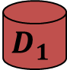
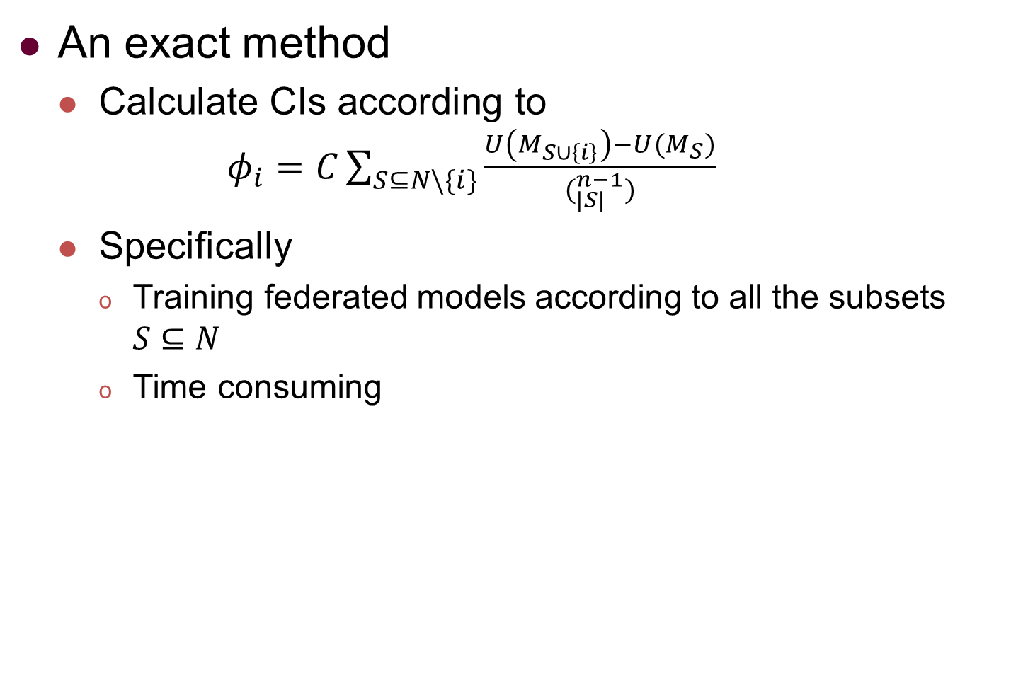
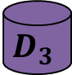
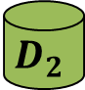
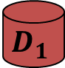


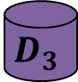




Methods
An exact method
Calculate CIs according to $φ_{i}=C\sum_{S⊆N\backslash \{i\}}{\frac{U\left(M_{S∪\left\{i\right\}}\right)−U(M_{S})}{(_{|S|}^{n−1})}}$
Specifically
Training federated models according to all the subsets $S⊆N$
Time consuming
$$D_{1}$$
$$D_{2}$$
$$D_{3}$$
$$D_{1}$$
$$D_{2}$$
$$D_{1}$$
$$D_{3}$$
$$D_{2}$$
$$D_{3}$$
$$D_{1}$$
$$D_{2}$$
$$D_{3}$$
Notes:
A direct method is to calculate the contribution indexes according to this formula.
Specifically, we need to train federated models according to all the subsets S of N to achieve the performance of all the federated models trained on all the combinations of all the n datasets.
As mentioned above, we use the set S to denote which data sets are used to trained a federated model.
For example, when S equals the set of 1 and 2, we train federated learning model by interacting with client 1 and client 2.
In this way, we have to train many extra models to get the contribution indexes, which will be time consuming.

Slide 20
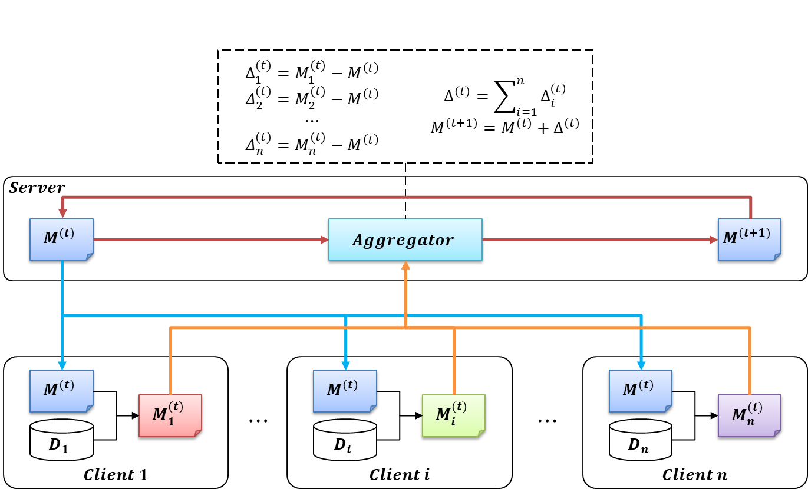
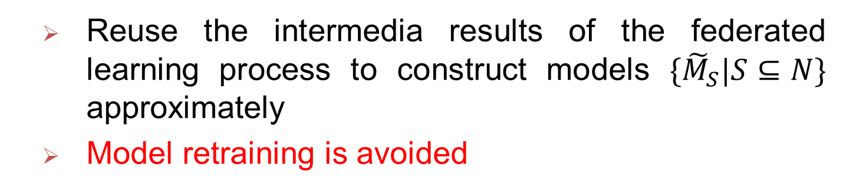
Methods
Reuse the intermedia results of the federated learning process to construct models $\{{\tilde{M}}_{S}|S⊆N\}$ approximately
Model retraining is avoided
Notes:
We propose two methods to improve the efficiency.
The key idea is that we reuse the intermedia results of the federated learning process to reconstruct all the models M S approximately, and use these approximate models to calculate the contribution indexes.
In this way, model retraining can be avoided and thus the efficiency can be improved a lot.

Slide 21



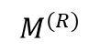

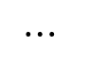











































Methods
Algorithm 1： One-Round Reconstruction (OR)
$$Round 1$$
Local Model
$$Round 2$$
Local Model
$$Round R$$
Local Model
Federated
Model
Federated
Model
Federated
Model
Federated
Model
$$M_{1}^{(0)}$$
$$M_{1}^{(1)}$$
$$M_{1}^{(R−1)}$$
$$⋯$$
$$M_{2}^{(0)}$$
$$M_{2}^{(1)}$$
$$M_{2}^{(R−1)}$$
$$M^{(0)}$$
$$⋯$$
$$M^{(1)}$$
$$⋯$$
$$M^{(R−1)}$$
$$⋯$$
$$M^{(R)}$$
$$M_{n}^{(0)}$$
$$M_{n}^{(1)}$$
$$M_{n}^{(R−1)}$$
Contribution Index
Client $1$
$$∆_{1}^{(0) }$$
$$∆_{1}^{(1) }$$
$$⋯$$
$$∆_{1}^{(R−1) }$$
$$φ_{1}$$
$$⋯$$
Client 2
$$∆_{2}^{(0) }$$
$$∆_{2}^{(1) }$$
$$⋯$$
$$∆_{2}^{(R−1) }$$
$$⋯$$
$$φ_{2}$$
$$⋯$$
$$⋯$$
$$⋯$$
$$⋯$$
$$⋯$$
$$⋯$$
$$⋯$$
$$∆_{n}^{(0) }$$
$$∆_{n}^{(1) }$$
$$⋯$$
$$∆_{n}^{(R−1) }$$
${\{\tilde{M}}_{S}\}_{S⊆N}$
$$φ_{n}$$
Client n
Notes:
This is our first method based on the above idea, which is called One Round Reconstruction, or OR in short
In each training round of federated learning, we record the gradients of all the clients, and use these gradients to approximate models trained on different combinations of the total n datasets

Slide 22


























Methods
Algorithm 1： One-Round Reconstruction (OR)
Contribution Index
Client $1$
$$∆_{1}^{(0) }$$
$$∆_{1}^{(1) }$$
$$⋯$$
$$∆_{1}^{(R−1) }$$
$$φ_{1}$$
$$⋯$$
Client 2
$$∆_{2}^{(0) }$$
$$∆_{2}^{(1) }$$
$$⋯$$
$$∆_{2}^{(R−1) }$$
$$⋯$$
$$φ_{2}$$
$$⋯$$
$$⋯$$
$$⋯$$
$$⋯$$
$$⋯$$
$$⋯$$
$$⋯$$
$$∆_{n}^{(0) }$$
$$∆_{n}^{(1) }$$
$$⋯$$
$$∆_{n}^{(R−1) }$$
${\{\tilde{M}}_{S}\}_{S⊆N}$
$$φ_{n}$$
Client n
$$Δ_{S}^{(t)}=\sum_{i∈S}{\frac{|D_{i}|}{\sum_{i∈S}{|D_{i}|}}Δ_{i}^{(t)}}$$
$${\tilde{M}}_{S}=M^{(0)}+\sum_{t=0}^{R−1}{Δ_{S}^{(t)}}$$
For example,
if $S=\{1\}$, ${\tilde{M}}_{\{1\}}=M^{(0)}+\sum_{t=0}^{R−1}{Δ_{\{1\}}^{(t)}}$=$M^{(0)}+\sum_{t=0}^{R−1}{Δ_{1}^{(t)}}$
if $S=\left\{1,2\right\}$, ${\tilde{M}}_{\{1,2\}}=M^{(0)}+\sum_{t=0}^{R−1}{Δ_{\{1,2\}}^{(t)}}$=$M^{(0)}+\sum_{t=0}^{R−1}{({\frac{\left|D_{1}\right|}{\left|D_{1}+D_{2}\right|}Δ}_{1}^{\left(t\right)}+{\frac{\left|D_{2}\right|}{\left|D_{1}+D_{2}\right|}Δ}_{2}^{\left(t\right)})}$
Notes:
The light green block shows the formula to reconstruct models.
We use delta i t to denote the gradient of client i at training round t.
Given a subset S, we use delta S t to denote the aggregated gradients of all the clients in S, which is the weighted average of delta i t for all i in S
Then, we use all the delta S t from different training rounds to update the initial global model to get an approximated model M S
The light orange block shows two example.
If S is a singleton with the element of 1, we just need to update the model M 0 with all the delta 1 t from different training rounds
If S is the set of 1 and 2, we need to update the model M 0 with the weighted average of the gradients of client 1 and client 2 from different training rounds.

Slide 23




Methods
Algorithm 1： One-Round Reconstruction (OR)
$$Δ_{S}^{(t)}=\sum_{i∈S}{\frac{|D_{i}|}{\sum_{i∈S}{|D_{i}|}}Δ_{i}^{(t)}}$$
$${\tilde{M}}_{S}=M^{(0)}+\sum_{t=0}^{R−1}{Δ_{S}^{(t)}}$$
$$\{{\tilde{M}}_{S}|S⊆N\}$$
$$φ_{i}=C\sum_{S⊆N\backslash \{i\}}{\frac{U\left(M_{S∪\left\{i\right\}}\right)−U(M_{S})}{(_{|S|}^{n−1})}}$$
$$φ_{1},φ_{2},⋯,φ_{n}$$
Notes:
In this way, for all the nonempty subset S of N, we can construct a model M S
With these models, after evaluating their performance on the standard test, we can calculate the contribution indexes directly.

Slide 24















Methods
Algorithm 2： Multi-Rounds Reconstruction (MR)
$$Round t+1$$
Local Model
$$Δ_{S}^{(t)}=\sum_{i∈S}{\frac{|D_{i}|}{\sum_{i∈S}{|D_{i}|}}Δ_{i}^{(t)}}$$
${\tilde{M}}_{S}^{(t+1)}=M^{(t)}+$ $Δ_{S}^{(t)}$
Federated
Model
$$M_{1}^{(t)}$$
$$M_{2}^{(t)}$$
$$M^{(t)}$$
$$⋯$$
$$M_{n}^{(t)}$$
$$\{{\tilde{M}}_{S}^{(t+1)}|S⊆N\}$$
Client $1$
$$φ_{1}^{(t+1)}$$
$$φ_{2}^{(t+1)}$$
Client 2
$$⋯$$
$$⋯$$
$$φ_{1}^{(t+1)},φ_{2}^{(t+1)},⋯,φ_{n}^{(t+1)}$$
Client n
$$φ_{n}^{(t+1)}$$
Notes:
Our second method is called multi-rounds reconstruction, or MR in short
The difference is that in MR, we calculate a set of contribution indexes in each round.
Specifically, in each round, we use the weighted average of the gradients to update the current global model in federated learning.
We then evaluate these models on the standard test set to get their performance and calculate a set of contribution indexes for the current training round.

Slide 25
















Methods
Algorithm 2： Multi-Rounds Reconstruction (MR)
$$Round 1$$
Local Model
$$Round 2$$
Local Model
$$Round R$$
Local Model
Federated
Model
Federated
Model
Federated
Model
Federated
Model
$$M_{1}^{(0)}$$
$$M_{1}^{(1)}$$
$$M_{1}^{(R−1)}$$
$$⋯$$
$$M_{2}^{(0)}$$
$$M_{2}^{(1)}$$
$$M_{2}^{(R−1)}$$
$$M^{(0)}$$
$$⋯$$
$$M^{(1)}$$
$$⋯$$
$$M^{(R−1)}$$
$$⋯$$
$$M^{(R)}$$
$$M_{n}^{(0)}$$
$$M_{n}^{(1)}$$
$$M_{n}^{(R−1)}$$
Contribution Index
$$φ_{1}^{(1)}$$
$$φ_{1}^{(2)}$$
$$⋯$$
$$φ_{1}^{(R)}$$
Client $1$
$$φ_{2}^{(1)}$$
$$φ_{2}^{(2)}$$
$$⋯$$
$$φ_{2}^{(R)}$$
Client 2
$$⋯$$
$$⋯$$
$$⋯$$
$$⋯$$
$$⋯$$
Client n
$$φ_{n}^{(1)}$$
$$φ_{n}^{(2)}$$
$$⋯$$
$$φ_{n}^{(R)}$$
Notes:
Thus, for all the R training rounds, we have R sets of contribution indexes in total.

Slide 26














Methods
Algorithm 2： Multi-Rounds Reconstruction (MR)
$$Round 1$$
Local Model
$$Round 2$$
Local Model
$$Round R$$
Local Model
Federated
Model
Federated
Model
Federated
Model
Federated
Model
$$M_{1}^{(0)}$$
$$M_{1}^{(1)}$$
$$M_{1}^{(R−1)}$$
$$⋯$$
$$M_{2}^{(0)}$$
$$M_{2}^{(1)}$$
$$M_{2}^{(R−1)}$$
$$M^{(0)}$$
$$⋯$$
$$M^{(1)}$$
$$⋯$$
$$M^{(R−1)}$$
$$⋯$$
$$M^{(R)}$$
$$M_{n}^{(0)}$$
$$M_{n}^{(1)}$$
$$M_{n}^{(R−1)}$$
Contribution Index
$${λ^{0}φ}_{1}^{(1)}$$
$${λ^{1}φ}_{1}^{(2)}$$
$$⋯$$
$${λ^{R−1}φ}_{1}^{(R)}$$
$$φ_{1}$$
Client $1$
$${λ^{0}φ}_{2}^{(1)}$$
$${λ^{1}φ}_{2}^{(2)}$$
$$⋯$$
$${λ^{R−1}φ}_{2}^{(R)}$$
$$φ_{2}$$
Client 2
$$⋯$$
$$⋯$$
$$⋯$$
$$⋯$$
$$⋯$$
$$⋯$$
$$⋯$$
Client n
$${λ^{0}φ}_{n}^{(1)}$$
$${λ^{1}φ}_{n}^{(2)}$$
$$⋯$$
$${λ^{R−1}φ}_{n}^{(R)}$$
$$φ_{n}$$
Notes:
What we next do is to aggregated these contribution indexes from different training rounds to get the final result.

Slide 27
















Methods
Algorithm 2： Multi-Rounds Reconstruction (MR)
$${λ^{0}φ}_{1}^{(1)}$$
$${λ^{1}φ}_{1}^{(2)}$$
$$⋯$$
$${λ^{R−1}φ}_{1}^{(R)}$$
$$φ_{1}$$
Client $1$
$${λ^{0}φ}_{2}^{(1)}$$
$${λ^{1}φ}_{2}^{(2)}$$
$$⋯$$
$${λ^{R−1}φ}_{2}^{(R)}$$
$$φ_{2}$$
Client 2
$$⋯$$
$$⋯$$
$$⋯$$
$$⋯$$
$$⋯$$
$$⋯$$
$$⋯$$
Client n
$${λ^{0}φ}_{n}^{(1)}$$
$${λ^{1}φ}_{n}^{(2)}$$
$$⋯$$
$${λ^{R−1}φ}_{n}^{(R)}$$
$$φ_{n}$$
$$φ_{i}=\sum_{t=1}^{R}{λ^{t}⋅φ_{i}^{(t)}}$$
Notes:
The aggregation is perform by this formula.
We use a parameter lambda to denote the decay factor to assign a smaller weight for a larger round t and sum these weighted contribution indexes up to get the final result.
The idea behind is that that with the increment of the iteration rounds, the global model is influenced more and more by all the data sets jointly. Thus, we give higher weights for the earlier rounds.

Slide 28
Outline
Background and Motivation
Preliminary and Definition
Methods
Experiments
Conclusion
Notes:
We next demonstrate the experimental results.

Slide 29
Experiments
Dataset and Pre-processing
MNIST
Remove the minimum number of instances such that there are the same number of instances with different labels in the training and test data set
Split the training set in to five data sets
With the same distribution and the same data size
With different distributions and the same data size
With the same distribution and different data sizes
With noised data on labels and the same data size
With noised data on features and the same data size
Notes:
We use the MNIST data set and pre-process the data set by remove the minimum number of instances such that there are the same number of instances with different labels in the training and test data set
Then, we split the training set into five data sets with different settings to let them have different data size, distribution and quality.

Slide 30

Experiments
Compared Methods
Exact
Extended-TMC-Shapley: Extended from Algorithm 1 in ICML’19
Extended GTB: Extended from Algorithm 1 in AISTATS’19
OR
MR
$$φ_{i}=C\sum_{S⊆N\backslash \{i\}}{\frac{U\left(M_{S∪\left\{i\right\}}\right)−U(M_{S})}{(_{|S|}^{n−1})}}$$
Our Methods
Notes:
We compare five methods.
The first method training models according to the subset S and then calculate according to the formula directly.
The second and third methods are extended from two recent works.
They are both sample-based methods, which sample some subsets S of N and train models by federated learning to get the performance of M S to approximate contribution indexes.
The final two are our methods.

Slide 31

Experiments
Metrics
Time: Include both the time of calculating CIs and the training time of federated models.
Cosine distance $D_{C}$
$D_{C}=1−\cos\left(φ^{∗},φ\right)=1−\frac{\sum_{i=1}^{n}{φ_{i}^{∗}×φ_{i}}}{\sqrt{\sum_{i=1}^{n}{φ_{i}^{∗}×φ_{i}^{∗}}}×\sqrt{\sum_{i=1}^{n}{φ_{i}×φ_{i}}}}$
Euclidean distance $D_{E}=\sqrt{\sum_{i=1}^{n}{{\left(φ_{i}^{∗}−φ_{i}\right)}^{2}}}$
Maximum difference $D_{M}=\max_{i=1}^{n}|φ_{i}^{∗}−φ_{i}|$
Normalized vector of the exact CIs
Normalized vector of CIs calculated by some method
Notes:
We evaluation different methods on four metrics, namely time, cosine distance, Euclidean distance and Maximum difference.
The time includes both the time of calculating CIs and the training time of federated models, and can be used to measure the efficiency of different methods.
For the last three metrics, we normalize the vector of CIs calculated by some method and compare it with the Normalized vector of the exact Cis

Slide 32

Experiments
Efficiency: OR>MR>Others
Effectiveness: OR≈MR>>Others
With the same distribution and the same data size
Notes:
This is the result on the setting of the five parts of data with the same distribution and the same data size.
It can be seen that OR and MR are more efficient than others.
Besides, the results of OR and MR can approximate the exact result very well.

Slide 33
Experiments
Efficiency: OR>MR>Others
Effectiveness: OR≈MR>>Others
With different distributions and the same data size
Notes:
This is the result on the setting of the five parts of data with different distributions and the same data size.
In this setting the superiority of OR and MR on time is more obvious.
Besides, OR and MR are still the most effective methods.

Slide 34

Experiments
Efficiency: OR>MR>Others
Effectiveness: OR≈MR>Others
With the same distribution and different data sizes
Notes:
This is the result on the setting of the five parts of data with the same distribution and different data sizes

Slide 35

Experiments
Efficiency: OR>MR>Others
Effectiveness: OR≈MR>>Others
With noised data on features and the same data size
Notes:
This is the result on the setting of the five parts of data with noised data on features and the same data size.
OR and MR still consumes the less time while achieve more accurate result.

Slide 36
Experiments
Efficiency: OR>MR>Others
Effectiveness: MR> Extended-TMC-Shapley> OR> Extended-GTB
With noised data on labels and the same data size
Notes:
This is the result on the setting of the five parts of data with noised data on labels and the same data size.
It can be seen that although OR is still the most efficient, its performance of OR degenerates heavily.
However, MR still performs well.
Thus, it seems that OR is not robust when the data has noised labels.

Slide 37


Experiments
Summary
Efficiency
OR>MR>>Others 2x-100x
Effectiveness
In most cases: OR≈MR>Others
OR is not robust when the labels are noised
MR is robust and stable
Notes:
To summary, in terms of efficiency, OR and MR outperforms other methods by up to 2 to 100 times.
In terms of effectiveness, in most cases OR and MR achieve similar performance and are better than other methods.
However, when the labels are noised, OR degenerates heavily.
MR is robust and stable.

Slide 38
Outline
Background and Motivation
Preliminary and Definition
Methods
Experiments
Conclusion
Notes:
We last conclude our work

Slide 39
Conclusion
Define a concept called Contribution Index based on Shapley value to measure the contribution of different data providers
Propose two gradient-based methods, whose key idea is to reconstruct models through the intermediate results of the federated learning
Experiments on the MNIST dataset demonstrate our methods can approximate the exact Contribution Index by definition effectively and speed up by 2x-100x compared with other baselines
Notes:
In this paper, we Define a concept called Contribution Index based on Shapley value to measure the contribution of different data providers
To calculate contribution indexes efficiently, we Propose two gradient-based methods, whose key idea is to reconstruct models through the intermediate results of the federated learning
We conduct Experiments on the MNIST dataset and the results demonstrate that our methods can approximate the exact Contribution Index by definition effectively and speed up by 2x-100x compared with other baselines

Slide 40
Thank you!

Slide 41



Background and Motivation
Federated learning: Taxonomy
Individual Federated Learning: A large number of data providers, each with a small scale of data
Enterprise Federated Learning: A small number of data providers, each with a large scale of data

Slide 42


Background and Motivation
Federated learning: Taxonomy
Horizontal Federated Learning： Each data sets have the same attributes
Vertical Federated Learning: Each data sets have different attributes
$$D_{1}$$
$$D_{2}$$
$$…$$
$$D_{n}$$
$$D_{1}$$ | $$D_{2}$$ | $$⋯$$ | $$D_{n}$$

Slide 43

Preliminary and Definition
Federated Learning Framework
$$Δ_{1}^{(t)}=M_{1}^{(t)}−M^{\left(t\right)}$$
$$Δ_{2}^{(t)}=M_{2}^{(t)}−M^{\left(t\right)}$$
$$⋯$$
$$Δ_{n}^{(t)}=M_{n}^{(t)}−M^{\left(t\right)}$$
$$Δ^{(t)}=\sum_{i=1}^{n}{Δ_{i}^{\left(t\right)}}$$
$$M^{(t+1)}=M^{(t)}+Δ^{(t)}$$
$$Server$$
$$M^{(t)}$$
$$Aggregator$$
$$M^{(t+1)}$$
$$Client 1$$
$$Client i$$
$$Client n$$
$$M^{(t)}$$
$$M^{(t)}$$
$$M^{(t)}$$
$$M_{1}^{(t)}$$
$$⋯$$
$$M_{i}^{(t)}$$
$$⋯$$
$$M_{n}^{(t)}$$
$$D_{1}$$
$$D_{i}$$
$$D_{n}$$

Slide 44











Preliminary and Definition
Federated Learning Framework
$$M^{(t)}$$
$$Client 1$$
$$Client i$$
$$Client n$$
$$M^{(t)}$$
$$M^{(t)}$$
$$M^{(t)}$$
$$M_{1}^{(t)}$$
$$⋯$$
$$M_{i}^{(t)}$$
$$⋯$$
$$M_{n}^{(t)}$$
$$D_{1}$$
$$D_{i}$$
$$D_{n}$$

